Slide 1
Sp MISCELLANEOUS TOPICS

Slide 2
Topics
User Centric View vs. System Centric View of System Software
Language Processor Development Tools (Lex, Yacc)
Assembly Language Program Conversion into Machine Code

Slide 3
User Centric View
vs.
System Centric View of System Software

Slide 4
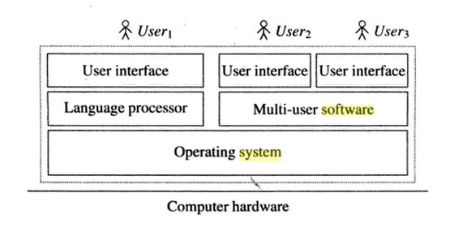
A View of System Software

Slide 5
System-Centric View of System Software
user-centric view of system software includes system programs that assist one user in fulfilling her computational needs.
It contains two kinds of system programs
language processors and
system programs in the operating system.

Slide 6
User-Centric View of System Software
A language processor contributes to 'translating' a user's needs into a program form that a computer system can understand and execute.
A system program provides an interface between user program and the hardware.
It allocates resources such as memory and input-output devices.

Slide 7
User-Centric View of System Software
The language processor takes different forms depending on the nature of the computational activity of a user.
If the activity is aimed at developing a program that is to be used repeatedly, the language processor can be the compiler, an assembler, a linker or loader, or a debugger.

Slide 8
User-Centric View of System Software
If the activity is aimed at developing a program for a small number of uses, the language processor can be an interpreter of a programming language that itself 'performs' the computation.

Slide 9
System Centric View
of System Software

Slide 10
System Centric View of System Software
The system-centric view of system software has system programs that achieve effective utilization of a computer system.
These system programs provide efficient use of a computer's resources by sharing them among several programs.

Slide 11
System Centric View of System Software
The system programs in this view provide user’s convenience through several means:
by allocating resources to programs and switching their execution so that all programs make good progress, and by providing facilities for short and long term storage of programs and data in files.

Slide 12
Language Processor Development Tools

Slide 13
Language Processor Development Tools
Two widely used language processor development tools are :
the lexical analyzer generator LEX and
the parser generator YACC.

Slide 14
Language Processor Development Tools
The input to these tools are specifications of the lexical and syntactic constructs of a programming language L, and the semantic actions that should be performed on recognizing the constructs.

Slide 15
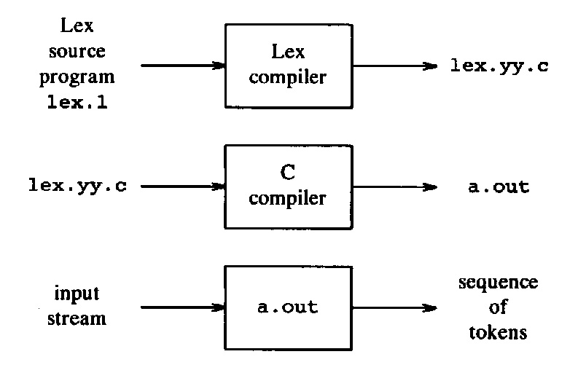
Creating Lexical analyzer with lex

Slide 16
LEX
Input to LEX consists of two components.
A specification of strings that represents the lexical units.
This specification is in the form of regular expressions.
A specification of semantic actions that are aimed at building the intermediate representation.
IR produced by a scanner would consist of a set of tables of lexical units and a sequence of tokens for the lexical units occurring in a source statement.

Slide 17
LEX
The tokens generated by LEX would be invoked by a parser whenever the parser needs the next token.
Accordingly, each semantic action would perform some table building actions and return a single token.

Slide 18
LEX Example
/* To Print out all the Numbers from file */
%%
[0-9]+ { printf("%s is number\n", yytext); }
.|\n { ;}
%%
main(int argc, char *argv[])
{
yyin=fopen(argv[1],"r");
yylex();
}
int yywrap()
{
return 1;
}
a.txt (Input)
----------------------
Code of SP is 2150708

Slide 19
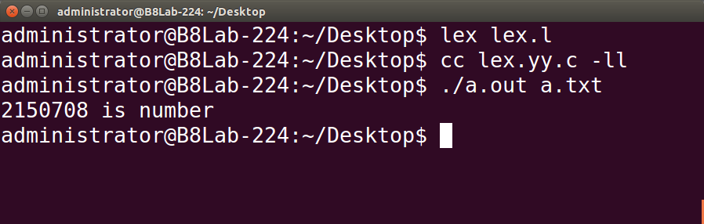
LEX

Slide 20
YACC
Each Rule input to YACC has a string specification that resembles a production of a grammar, which has
a nonterminal on the LHS and
a few alternatives on the RHS.
For simplicity, we will refer to a string specification as a production.
YACC generates an LALR(1) parser from the productions, which is a bottom-up parser.

Slide 21
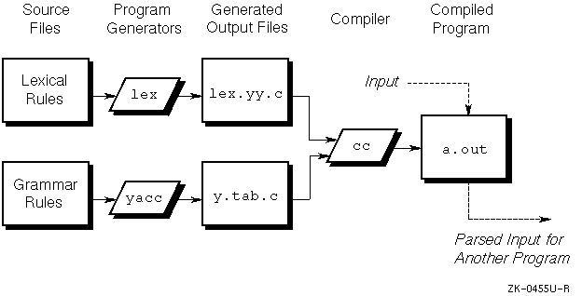
Lex and Yacc

Slide 22
YACC
The parser would operate as follows:
For a shift action, it would invoke the scanner to obtain the next token and continue the parse by using that token.
While performing a reduce action in accordance with a production, it would perform the semantic action associated with that production.

Slide 23
Assembly Language Program Conversion into Machine Code

Slide 24
